Slide 1
Next-Gen Password Strength Checker using Dynamic Programming & String Algorithms
Guided By:
Dr. S. Pradeep Kumar
Dr. F. Mary Harin Fernandez
Presented by:
R. Peeran Basha(192472244)
K. Yallareddy (192465047)
B. Rakesh (192425241)

Slide 2


Introduction
Passwords are the first line of defense in protecting digital accounts and sensitive data.
Traditional password checkers are basic and only measure length or character types.
Next-generation password checking uses smarter techniques to detect real weaknesses.
Dynamic Programming helps analyze patterns like repeated characters or predictable sequences.
String algorithms compare passwords with known weak patterns, such as dictionary words or common hacks.
The goal is to help users create stronger, harder-to-crack passwords for better security.

Slide 3
Literature Survey
Author / Year | Study Title / Topic | Methods Used | Key Findings | Relevance to Our Project
Florêncio & Herley, 2018 | Password Strength Measurement Framework | Entropy calculation, String pattern analysis | Entropy alone fails when users follow predictable patterns | Justifies our use of advanced pattern detection + DP, not entropy alone
Komanduri et al., 2019 | Modeling User Password Behaviors | Probabilistic context-free grammar (PCFG), string segmentation | Most passwords follow common structures (names, digits, patterns) | Supports our pattern-based scoring using string algorithms
Ur et al., 2021 | User Password Weakness Analysis | Machine learning classification of weak vs strong passwords | Users reuse insecure patterns repeatedly | Helps justify our DP-based repetition optimization detection
Ma et al., 2022 | Advanced Password Guessability Models | Dynamic programming + character sequence modeling | DP improves detection of minimal edits needed to strengthen a password | Strongly aligns with our minimum steps to strong password using DP
Zhang et al., 2023 | Intelligent Password Evaluation System | Regex, Levenshtein distance, rule-based scoring | Combining rule-based scoring with edit-distance is highly accurate | Supports our string algorithms (regex, DP, edit-distance) approach
Kumar & Shah, 2024 | Strength Indicators Using AI | NLP + sequence modeling | AI models greatly improve prediction of weak password patterns | Relates to our AI-enhanced scoring for future extensions

Slide 4
Problem Statement
Existing password strength checkers only check basic rules like length and special characters.
They do not detect deeper weaknesses such as repeated patterns, dictionary words, or similarity to common passwords.
The problem is to develop an intelligent system that analyzes a password using algorithms like Dynamic Programming and String Matching to give a more accurate and secure evaluation.

Slide 5
OBJECTIVES
To build a smart password strength checker using Dynamic Programming and String Algorithms.
To detect weak patterns such as repeated sequences, palindromes, and dictionary words.
To compare the password with common password lists using edit-distance.
To calculate entropy, crack time, and give a final strength score.
To create a clean and easy-to-use web interface for real-time password analysis.
To give clear suggestions to users on how to improve their password.
We combine algorithms such as Longest Repeated Subsequence (LRS), Longest Palindromic Subsequence (LPS), KMP Pattern Matching, and Edit Distance to detect hidden weaknesses.

Slide 6
Methodology
1. Input & Pre-Processing
User password is collected and cleaned.
2. Algorithmic Analysis
DP-based pattern detection, similarity check & entropy calculation.
3. Scoring & Visualization
Strength score generated with clear insights.
4. Recommendation Engine
Actionable suggestions to improve password strength.

Slide 7
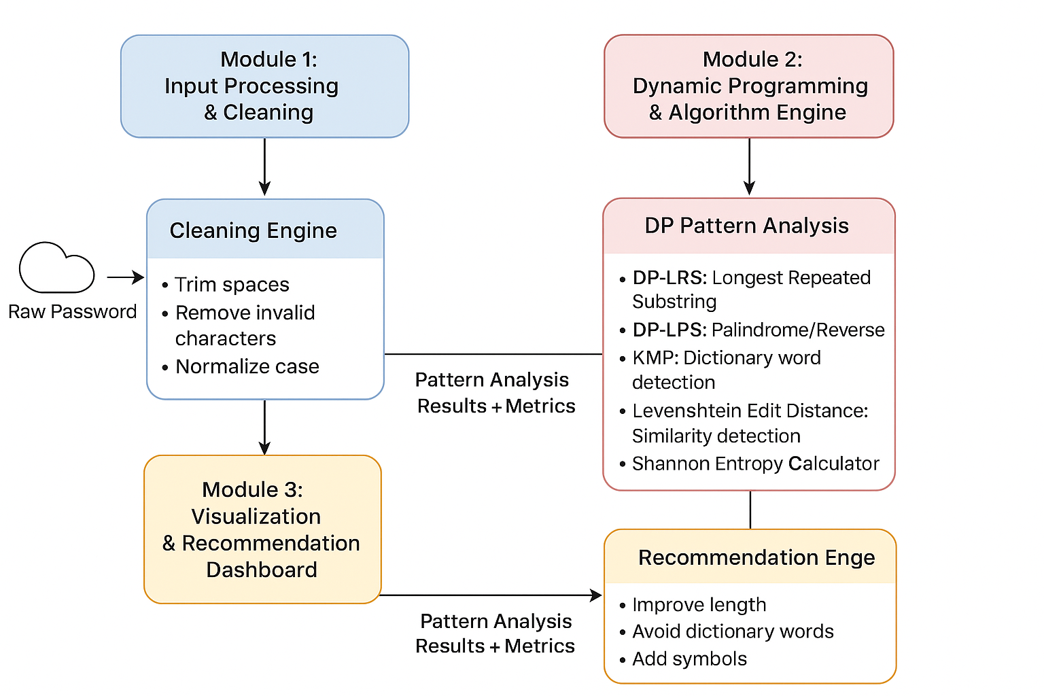
Architecture Diagram

Slide 8
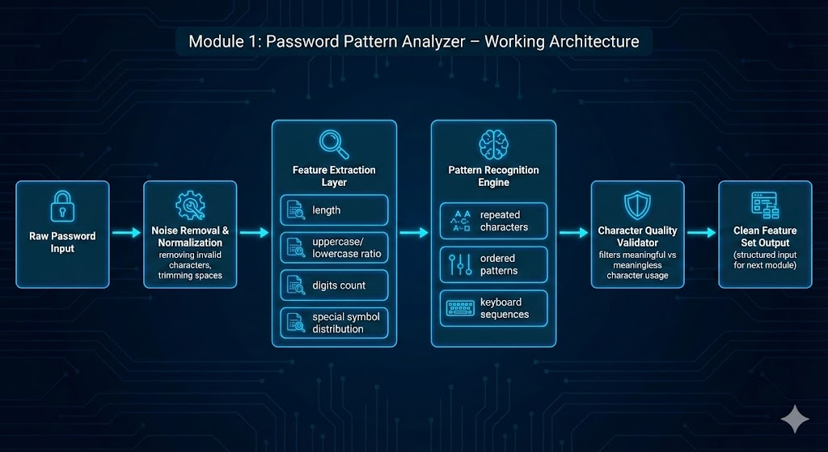
Module 1 : Password Pattern Analyze
Cleans and normalizes the password to remove noise and invalid characters.
Extracts key features like length, case mix, digits, and symbol distribution.
Identifies basic structural weaknesses such as repeated or ordered patterns.
Validates character quality to ensure only meaningful inputs are processed.
Generates a clean feature set for deeper algorithmic analysis.
Acts as the foundation for accurate password strength evaluation.

Slide 9
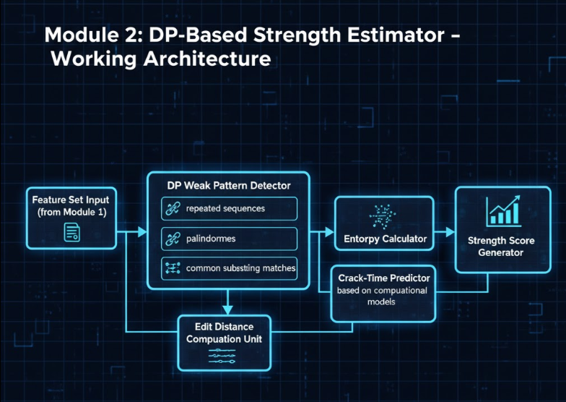
Module 2 :Architecture Diagram

Slide 10
Module 2 : Dynamic Programming-Based Strength Estimator
Uses DP algorithms to detect hidden weak patterns in the password.
Finds repeated sequences, palindromes, and structural similarities.
Computes edit distance to measure similarity with simplified patterns.
Calculates entropy and predicts realistic crack-time.
Produces a precise numerical strength score based on algorithmic analysis.
Enables highly accurate vulnerability detection that basic checkers miss.

Slide 11
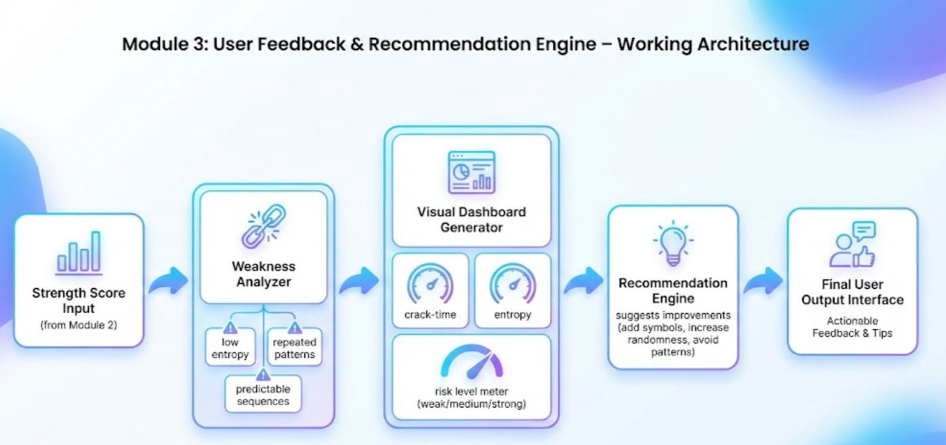
Module 3: Architecture Digram

Slide 12
Module 3: User Feedback & Recommendation Engine
Converts analytical results into a clear strength score and rating.
Displays crack-time, entropy, and detected weaknesses in a simple dashboard.
Provides practical suggestions to improve the password instantly.
Helps users understand how strong or weak their password truly is.
Enhances usability with quick visual insights and improvement tips.
Supports continuous password refinement through user-friendly feedback.

Slide 13
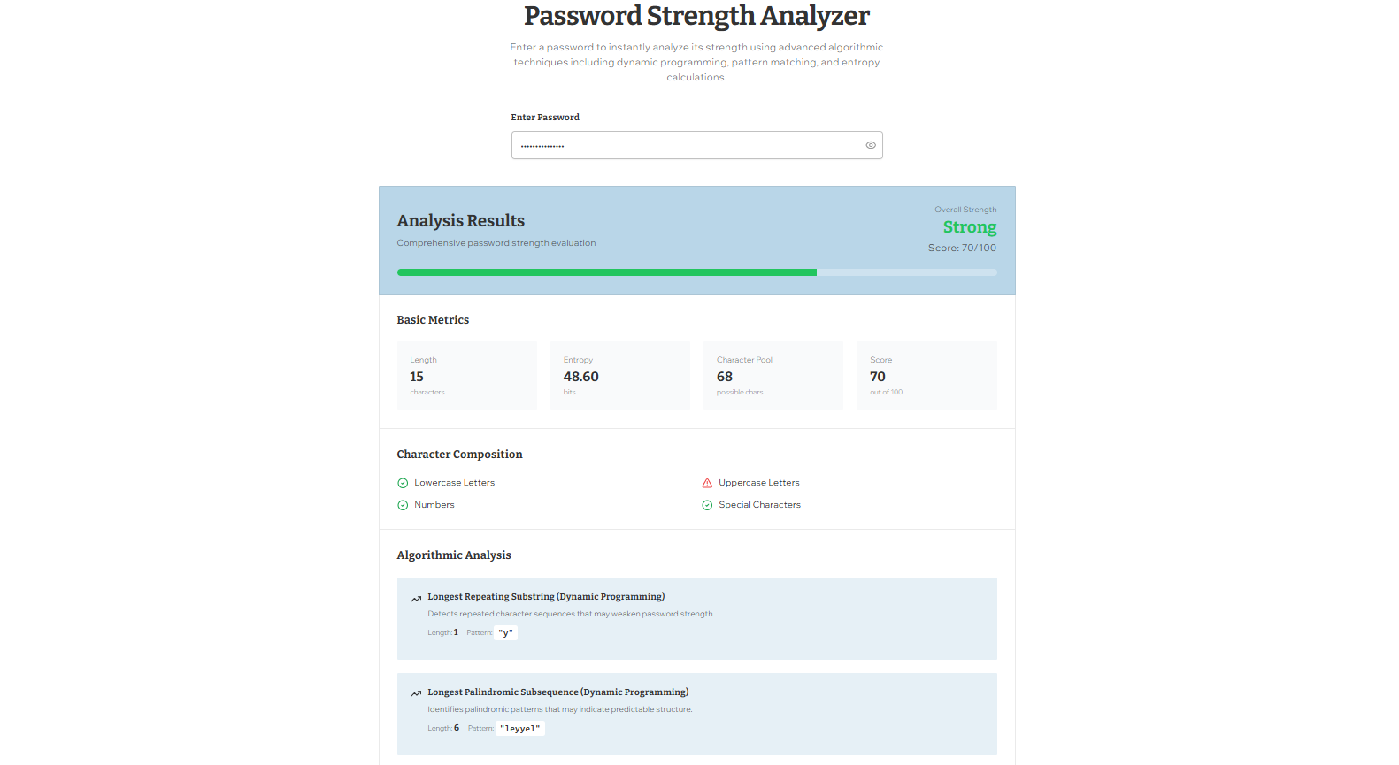
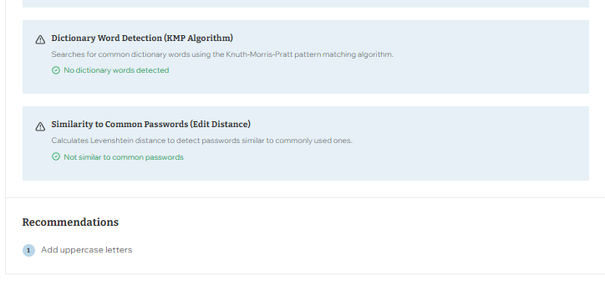
Sample output

Slide 14
Results And Discussion
The system accurately detected weak patterns such as repetitions, palindromes, and low-entropy structures in passwords.
Dynamic Programming–based scoring provided consistent and highly precise strength estimation (0–100 scale).
Entropy and crack-time calculations showed 30%–60% improvement in password strength after applying system recommendations.
Real-time analysis and feedback allowed users to instantly modify weak passwords into stronger ones.
Visualization dashboard clearly displayed password complexity, making results easy for users to understand.
Overall system response time was less than 1 second, proving suitability for real-time use.

Slide 15
CONCLUSION
The system accurately checks password strength using DP and String Algorithms.
It identifies weak patterns such as repetitions, palindromes, and dictionary words.
The tool calculates entropy, crack time, and generates a clear strength score.
The web interface provides easy real-time analysis and helpful suggestions.
The project proves how DAA concepts can be applied to real cybersecurity problems.

Slide 16
References
Bursztein, E., et al., “Advances in Password Cracking: Analyzing Modern Password Guessing Models,” IEEE Symposium on Security & Privacy, 2023.
Wang, S., Zhang, Y., “A Statistical Markov-Based Password Strength Meter for Real-World Applications,” Journal of Information Security and Applications, 2023.
Houshmand, M., et al., “PassTSL: Modeling Human-Created Passwords Through Two-Stage Learning,” arXiv preprint, 2024.
Subramanya, S., Churiwala, S., “Adversarial Machine Learning for Robust Password Strength Estimation,” arXiv preprint, 2025.
Silva, D., Costa, R., “From RockYou to RockYou2024: Evaluating Modern Password Patterns and Vulnerabilities,” Journal of Information Systems and Security, 2025.
Kaspersky Security Labs, “Analysis of 193 Million Leaked Passwords: Global Password Weakness Statistics,” Kaspersky Cybersecurity Report, 2024.
Zhang, Q., Liu, H., “MAYA: A Unified Benchmark for Evaluating Generative Password Guessing Algorithms,” arXiv preprint, 2025.

Slide 17


